Slide 1
Introduction to Digital Electronics

Slide 2
Lecture 4 Number System
Lecture delivered by:
Deepak V.

Slide 3
Objectives
At the end of this lecture, student will be able to:
Acquire the knowledge of Positional-Value System
List of the Various radix
Distinguish between various number systems
Acquire the knowledge of Data Organization

Slide 4
Topics
Positional-Value System
Decimal Number System
Octal number system
Binary Digits
Hexadecimal number system
Common Powers
Binary Codes

Slide 5
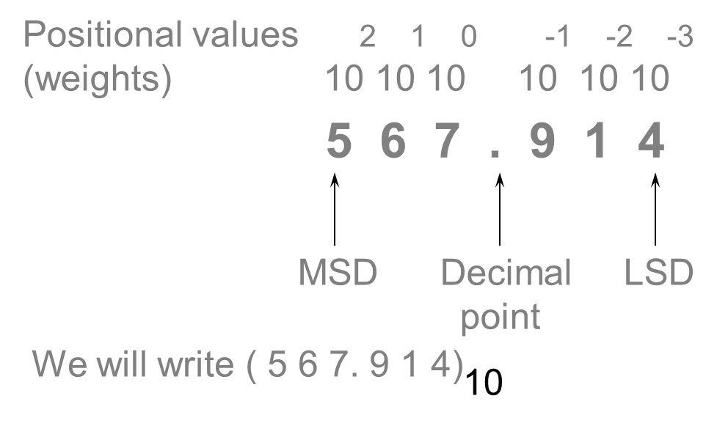
Positional-Value System
The value of a digit (“digit” from Latin word for finger) depends on its position

Slide 6
Decimal Number System
Base (also called radix) = 10
10 digits { 0, 1, 2, 3, 4, 5, 6, 7, 8, 9 }
Digit Position
Integer & fraction
Digit Weight
Weight = (Base) ^{Position}
Magnitude
Sum of “Digit x Weight”
Formal Notation
2
1
0
-1
-2
5
1
2
7
4
100
10
1
0.1
0.01
500
10
2
0.7
0.04
d₂*B²+d₁*B¹+d₀*B⁰+d₋₁*B⁻¹+d₋₂*B⁻²
(512.74)₁₀

Slide 7
Octal Number System
Base = 8
8 digits { 0, 1, 2, 3, 4, 5, 6, 7 }
Weights
Weight = (Base) ^{Position}
Magnitude
Sum of “Digit x Weight”
Formal Notation
64
8
1
1/8
1/64
5
1
2
7
4
2
1
0
-1
-2
5 *8²+1 *8¹+2 *8⁰+7 *8⁻¹+4 *8⁻²
=(330.9375)₁₀
(512.74)₈

Slide 8
Binary Number System
Base = 2
2 digits { 0, 1 }, called binary digits or “bits”
Weights
Weight = (Base) ^{Position}
Magnitude
Sum of “Bit x Weight”
Formal Notation
Groups of bits 4 bits = Nibble
8 bits = Byte
4
2
1
1/2
1/4
1
0
1
0
1
2
1
0
-1
-2
1 *2²+0 *2¹+1 *2⁰+0 *2⁻¹+1 *2⁻²
=(5.25)₁₀
(101.01)₂
1 0 1 1
1 1 0 0 0 1 0 1

Slide 9
Hexadecimal Number System
Base = 16
16 digits { 0, 1, 2, 3, 4, 5, 6, 7, 8, 9, A, B, C, D, E, F }
Weights
Weight = (Base) ^{Position}
Magnitude
Sum of “Digit x Weight”
Formal Notation
256
16
1
1/16
1/256
1
E
5
7
A
2
1
0
-1
-2
1 *16²+14 *16¹+5 *16⁰+7 *16⁻¹+10 *16⁻²
=(485.4765625)₁₀
(1E5.7A)₁₆

Slide 10
Common Powers
2⁻³ = 0.125 2⁻² = 0.25 2⁻¹ = 0.5 2⁰ = 1 2¹ = 2 2² = 4 2³ = 8 2⁴ = 16 2⁵ =32 2⁶ = 64 2⁷ = 128 2⁸ = 256 2⁹ = 512 2¹⁰ = 1024 2¹¹ = 2048 2¹² = 4096
16⁰ = 1 = 2⁰ 16¹ = 16 = 2⁴ 16² = 256 = 2⁸ 16³ = 4096 = 2¹²
2¹⁰ = 1024 = 1 K 2²⁰ = 1048576 = 1 M (1 Megabits) = 1024 K = 2¹⁰ x 2¹⁰ 2³⁰ = 1073741824 = 1 G (1 Gigabits)

Slide 11
Binary Codes
One Binary Digit (one bit) can take on values 0, 1. We can represent TWO values:
(0 = hot, 1 = cold), (1 = True, 0 = False), (1 = on, 0 = off) Two Binary digits (two bits) can take on values of 00, 01, 10, 11. We can represent FOUR values:
(00 = hot, 01 = warm, 10 = cool, 11 = cold)
Three Binary digits (three bits) can take on values of 000, 001, 010, 011, 100, 101, 110, 111. We can represent 8 values 000 = Black, 001 = Red, 010 = Pink, 011 = Yellow, 100 = Brown, 101 = Blue, 110 = Green , 111 = White

Slide 12
Contd..
N bits (or N binary Digits) can represent 2^{N} different values
(for example, 4 bits can represent 2⁴ or 16 different values) N bits can take on unsigned decimal values from 0 to 2^{N}-1.
Codes usually given in tabular form
000 001 010 011 100 101 110 111
black red pink yellow brown blue green white

Slide 13
Addition
Decimal Addition
1
1
Carry
5
5
+
5
5
1
1
0
= Ten ≥ Base

Slide 14
Binary Addition
Column Addition
1
1
1
1
1
1
1
1
1
1
0
1
= 61
= 23
+
1
0
1
1
1
1
0
1
0
1
0
0
= 84
≥ (2) 1 0

Slide 15
Binary Subtraction
Borrow a “Base” when needed
1
2
= (10)₂
0
2
2
0
0
2
1
0
0
1
1
0
1
= 77
= 23
−
1
0
1
1
1
0
1
1
0
1
1
0
= 54

Slide 16
Binary Multiplication
Bit by bit
1
0
1
1
1
x
1
0
1
0
0
0
0
0
0
1
0
1
1
1
0
0
0
0
0
1
0
1
1
1
1
1
1
0
0
1
1
0

Slide 17
Summary
Value of number is determined by multiplying each digit by a weight and then summing
Binary Number System has Radix = 2
Decimal Number System has radix = 10
Octal number system has radix = 8
Hexadecimal number system has radix = 16

